Slide 1
SCADA SYSTEM
CLASSIFICATION
NORWICH UNIVERISTY CENTER OF EXELLENCE IN DISTRIBUTED CONTROL SYSTEM SECURITY
SCADA SYSTEMS CLASSIFICATIONS (ILIA DORMISHEV, KRENAR KOMONI)

Slide 2
Agenda
NORWICH UNIVERISTY CENTER OF EXELLENCE IN DISTRIBUTED CONTROL SYSTEM SECURITY
Introduction
  History
  What is SCADA?
Classifications of a SCADA system
  Elements of SCADA system?
  Where is SCADA used?
  What types of SCADA are there?
Purpose of this research
Conclusion
SCADA SYSTEMS CLASSIFICATIONS (ILIA DORMISHEV, KRENAR KOMONI)

Slide 3
Introduction
NORWICH UNIVERISTY CENTER OF EXELLENCE IN DISTRIBUTED CONTROL SYSTEM SECURITY
SCADA (Supervisory Control and Data Acquisition) System
History
Why SCADA?
Definition of SCADA
SCADA SYSTEMS CLASSIFICATIONS (ILIA DORMISHEV, KRENAR KOMONI)

Slide 4
History
NORWICH UNIVERISTY CENTER OF EXELLENCE IN DISTRIBUTED CONTROL SYSTEM SECURITY
Egyptian supervisory
First half of the 20th century
Development from telemetry system
Weather predictions
Rail road tracks
Two way system
1960s idea for supervisory
1970s radio system
SCADA SYSTEMS CLASSIFICATIONS (ILIA DORMISHEV, KRENAR KOMONI)

Slide 5
Why SCADA?
NORWICH UNIVERISTY CENTER OF EXELLENCE IN DISTRIBUTED CONTROL SYSTEM SECURITY
Saves Time and Money
  Less traveling for workers (e.g. helicopter ride)
  Reduces man-power needs
  Increases production efficiency of a company
  Cost effective for power systems
  Saves energy
Reliable
Supervisory control over a particular system
SCADA SYSTEMS CLASSIFICATIONS (ILIA DORMISHEV, KRENAR KOMONI)

Slide 6
What is SCADA?
NORWICH UNIVERISTY CENTER OF EXELLENCE IN DISTRIBUTED CONTROL SYSTEM SECURITY
Supervisory Control and Data Acquisition
Supervisory
  Operator/s, engineer/s, supervisor/s, etc
Control
  Monitoring
  Limited
  Telemetry
  Remote/Local
Data acquisition
  Access and acquire information or data from the
  equipment
  Sends it to different sites through telemetry
  Analog / Digital
SCADA SYSTEMS CLASSIFICATIONS (ILIA DORMISHEV, KRENAR KOMONI)

Slide 7
Classifications
NORWICH UNIVERISTY CENTER OF EXELLENCE IN DISTRIBUTED CONTROL SYSTEM SECURITY
  Anatomy of a SCADA system?
    Elements of SCADA
    Levels of SCADA
  Where is SCADA used?
    Different applications of SCADA systems?
  What types of SCADA are there?
  Component manufacturers and system manufacturers of the SCADA systems?
    Automation Solutions
    Software
    Hardware
SCADA SYSTEMS CLASSIFICATIONS (ILIA DORMISHEV, KRENAR KOMONI)

Slide 8
Elements of SCADA
NORWICH UNIVERISTY CENTER OF EXELLENCE IN DISTRIBUTED CONTROL SYSTEM SECURITY
Elements of a SCADA system
  Sensors and actuators
  RTUs/PLCs
  Communication
  MTU
    Front End Processor
    SCADA server
    Historical/Redundant/Safety Server
    HMI computer
    HMI software
SCADA SYSTEMS CLASSIFICATIONS (ILIA DORMISHEV, KRENAR KOMONI)

Slide 9
Sensors
NORWICH UNIVERISTY CENTER OF EXELLENCE IN DISTRIBUTED CONTROL SYSTEM SECURITY
Types of sensors:
  Pressure sensors
  Temperature sensors
  Light sensors
  Humidity sensors
  Wind speed sensors
  Water level sensors
  Distance sensors
SCADA SYSTEMS CLASSIFICATIONS (ILIA DORMISHEV, KRENAR KOMONI)

Slide 10
Actuators
NORWICH UNIVERISTY CENTER OF EXELLENCE IN DISTRIBUTED CONTROL SYSTEM SECURITY
Actuators:
  Valves
  Pumps
  Motors
SCADA SYSTEMS CLASSIFICATIONS (ILIA DORMISHEV, KRENAR KOMONI)

Slide 11
RTUs
NORWICH UNIVERISTY CENTER OF EXELLENCE IN DISTRIBUTED CONTROL SYSTEM SECURITY
RTU – Remote Terminal Unit
  Intelligent to control a process and multiple processes
  Data logging and alarm handling
  Expandable
  Asks the field devices for information
  Can control IEDs (Intelligent Electronic Device)
  Slave/Master device
SCADA SYSTEMS CLASSIFICATIONS (ILIA DORMISHEV, KRENAR KOMONI)

Slide 12
Alarms
NORWICH UNIVERISTY CENTER OF EXELLENCE IN DISTRIBUTED CONTROL SYSTEM SECURITY
Types of alarms:
  Good alarms
  Critical failure alarms
SCADA SYSTEMS CLASSIFICATIONS (ILIA DORMISHEV, KRENAR KOMONI)

Slide 13
Safety instrumented systems
NORWICH UNIVERISTY CENTER OF EXELLENCE IN DISTRIBUTED CONTROL SYSTEM SECURITY
Actions:
  Override the normal control system
  Take over the actuators
SCADA SYSTEMS CLASSIFICATIONS (ILIA DORMISHEV, KRENAR KOMONI)

Slide 14
PLCs
NORWICH UNIVERISTY CENTER OF EXELLENCE IN DISTRIBUTED CONTROL SYSTEM SECURITY
PLC – Programmable Logic Controller
  Ladder logic
  Industrial computer that replaced relays
  Not a protocol converter
  Cannot control IEDs
  Communication compatibilities
  Takes actions based on its inputs
SCADA SYSTEMS CLASSIFICATIONS (ILIA DORMISHEV, KRENAR KOMONI)

Slide 15
Communication
NORWICH UNIVERISTY CENTER OF EXELLENCE IN DISTRIBUTED CONTROL SYSTEM SECURITY
Communication systems:
  Switched Telephone Network
  Leased lines
  Private Network (LAN/RS-485)
  Internet
  Wireless Communication systems
    Wireless LAN
    Global System for Mobile Communication
    (GSM) Network
    Radio modems
SCADA SYSTEMS CLASSIFICATIONS (ILIA DORMISHEV, KRENAR KOMONI)

Slide 16
Communication cont.
NORWICH UNIVERISTY CENTER OF EXELLENCE IN DISTRIBUTED CONTROL SYSTEM SECURITY
Protocols:
  MODBUS
  DNP 3.0
  Fieldbus
  Controller Area Network (CAN)
  Profibus
  DirectNet
  TCP/IP
  Ethernet
SCADA SYSTEMS CLASSIFICATIONS (ILIA DORMISHEV, KRENAR KOMONI)

Slide 17
Front End Processor
NORWICH UNIVERISTY CENTER OF EXELLENCE IN DISTRIBUTED CONTROL SYSTEM SECURITY
Front End Processor
  Gathers all communications and converts them
  into SCADA friendly communication
  Communication interface between several RTU
  channels and the host Master Station computer
SCADA SYSTEMS CLASSIFICATIONS (ILIA DORMISHEV, KRENAR KOMONI)

Slide 18
SCADA server
NORWICH UNIVERISTY CENTER OF EXELLENCE IN DISTRIBUTED CONTROL SYSTEM SECURITY
SCADA Server
  It can be a Web server
  Data logging
  Analyzing data
  Serve the clients through a firewall
  Clients connected in the corporation or connected
  outside through internet
  Real-time decision maker
  Asks RTU for information
SCADA SYSTEMS CLASSIFICATIONS (ILIA DORMISHEV, KRENAR KOMONI)

Slide 19
Historical server
NORWICH UNIVERISTY CENTER OF EXELLENCE IN DISTRIBUTED CONTROL SYSTEM SECURITY
Historical/Safety/Redundant Server
  Logs the data from the SCADA server and
  stores it as a backup, in case of a disaster
  It is basically a safety server
SCADA SYSTEMS CLASSIFICATIONS (ILIA DORMISHEV, KRENAR KOMONI)

Slide 20
HMI Computer
NORWICH UNIVERISTY CENTER OF EXELLENCE IN DISTRIBUTED CONTROL SYSTEM SECURITY
Human Machine Interface Computer
  Access on the SCADA Server
  Control the system
  Operator Interface
  Software
    User friendly
    Programmable (C, C++)
SCADA SYSTEMS CLASSIFICATIONS (ILIA DORMISHEV, KRENAR KOMONI)

Slide 21
DCS
NORWICH UNIVERISTY CENTER OF EXELLENCE IN DISTRIBUTED CONTROL SYSTEM SECURITY
DCS – Distributed Control System
  Process oriented – tendency to do something
  Not event oriented – does not depend on circumstances
  Local control over the devices
  Subordinate to SCADA
SCADA SYSTEMS CLASSIFICATIONS (ILIA DORMISHEV, KRENAR KOMONI)

Slide 22
Levels of SCADA
NORWICH UNIVERISTY CENTER OF EXELLENCE IN DISTRIBUTED CONTROL SYSTEM SECURITY
Four levels of SCADA system
  Level IV - Enterprise
    Corporate LAN/WAN
    World Wide Web
    Virtual Private Network
    Firewall for remote users
  Level III – SCADA / MTU
    Operator Workstations
    Control
    Engineering Workstations
    Servers – Data logging
SCADA SYSTEMS CLASSIFICATIONS (ILIA DORMISHEV, KRENAR KOMONI)

Slide 23
Levels of SCADA cont.
NORWICH UNIVERISTY CENTER OF EXELLENCE IN DISTRIBUTED CONTROL SYSTEM SECURITY
Four levels of SCADA system
  Level II – Telecommunication
    Fiber
    Radio
    Telephone leased line
    Protocols
  Level I – Field
    Devices
    RTUs / PLCs
    Sensors
SCADA SYSTEMS CLASSIFICATIONS (ILIA DORMISHEV, KRENAR KOMONI)

Slide 24
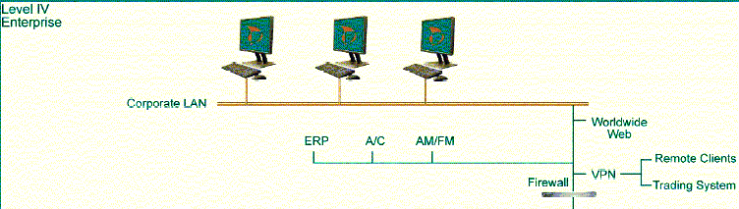
Level IV - Enterprise
NORWICH UNIVERISTY CENTER OF EXELLENCE IN DISTRIBUTED CONTROL SYSTEM SECURITY
SCADA SYSTEMS CLASSIFICATIONS (ILIA DORMISHEV, KRENAR KOMONI)

Slide 25
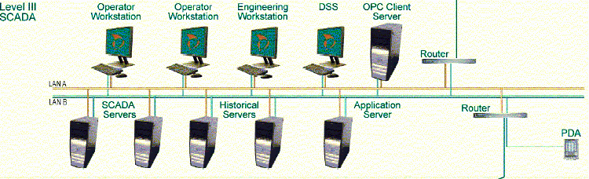
Level III - SCADA
NORWICH UNIVERISTY CENTER OF EXELLENCE IN DISTRIBUTED CONTROL SYSTEM SECURITY
SCADA SYSTEMS CLASSIFICATIONS (ILIA DORMISHEV, KRENAR KOMONI)

Slide 26

Level II and I
Telecommunication and Field
NORWICH UNIVERISTY CENTER OF EXELLENCE IN DISTRIBUTED CONTROL SYSTEM SECURITY
SCADA SYSTEMS CLASSIFICATIONS (ILIA DORMISHEV, KRENAR KOMONI)

Slide 27
Where is SCADA used?
NORWICH UNIVERISTY CENTER OF EXELLENCE IN DISTRIBUTED CONTROL SYSTEM SECURITY
Main SCADA applications:
Water and Wastewater
Power
Oil and Gas
Research facilities
Transportation
Security systems
Siren systems
Irrigation
Communication control
SCADA SYSTEMS CLASSIFICATIONS (ILIA DORMISHEV, KRENAR KOMONI)

Slide 28
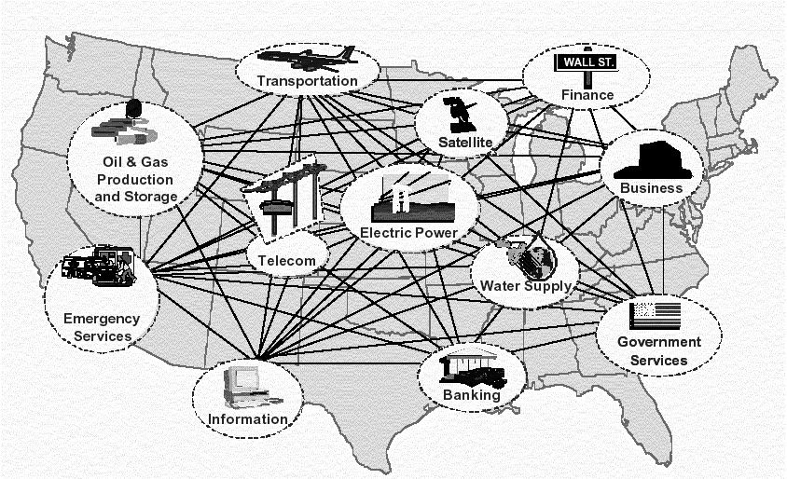
U.S. Infrastructure
NORWICH UNIVERISTY CENTER OF EXELLENCE IN DISTRIBUTED CONTROL SYSTEM SECURITY
Courtesy of Infrastructure Assurance Center
SCADA SYSTEMS CLASSIFICATIONS (ILIA DORMISHEV, KRENAR KOMONI)

Slide 29
SCADA examples
NORWICH UNIVERISTY CENTER OF EXELLENCE IN DISTRIBUTED CONTROL SYSTEM SECURITY
SCADA examples:
  Gas control systems
  Water control systems
  Power systems
SCADA SYSTEMS CLASSIFICATIONS (ILIA DORMISHEV, KRENAR KOMONI)

Slide 30
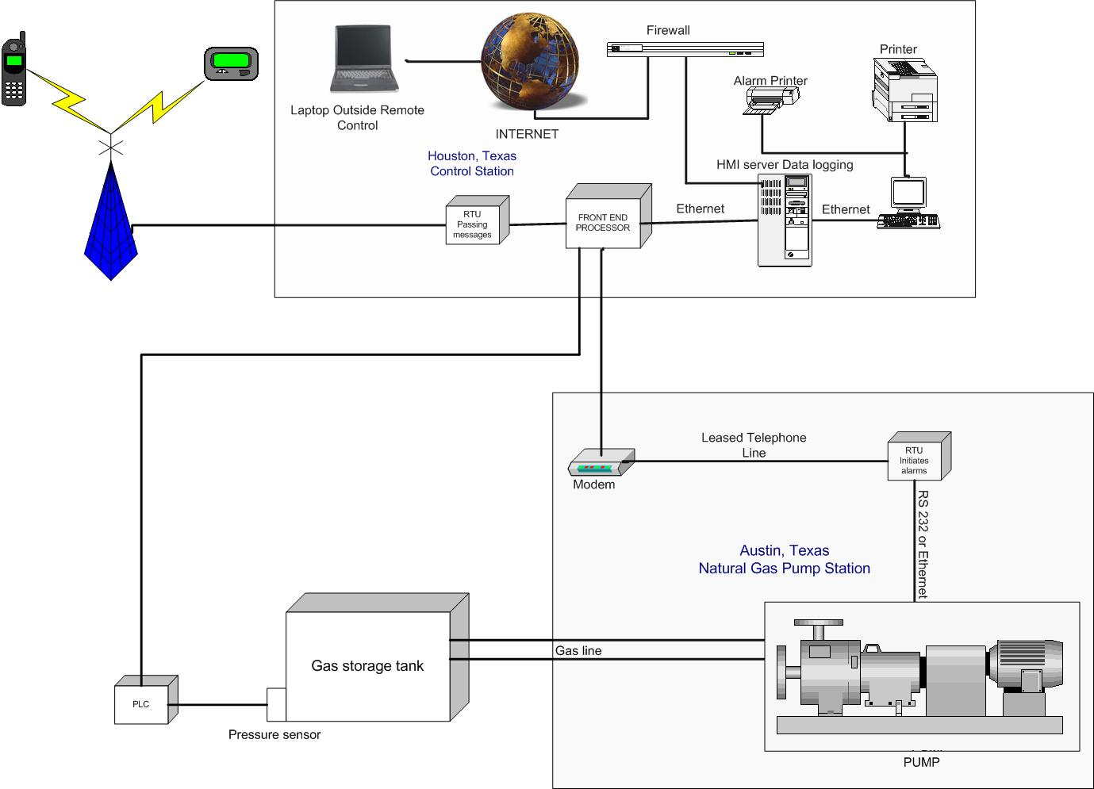
Gas SCADA
NORWICH UNIVERISTY CENTER OF EXELLENCE IN DISTRIBUTED CONTROL SYSTEM SECURITY
SCADA SYSTEMS CLASSIFICATIONS (ILIA DORMISHEV, KRENAR KOMONI)

Slide 31
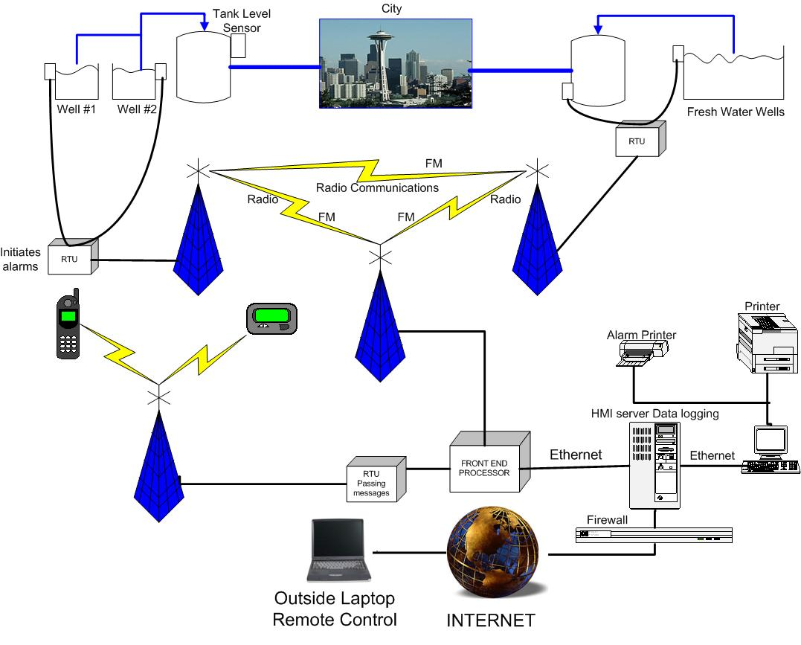
Water SCADA
NORWICH UNIVERISTY CENTER OF EXELLENCE IN DISTRIBUTED CONTROL SYSTEM SECURITY
SCADA SYSTEMS CLASSIFICATIONS (ILIA DORMISHEV, KRENAR KOMONI)

Slide 32
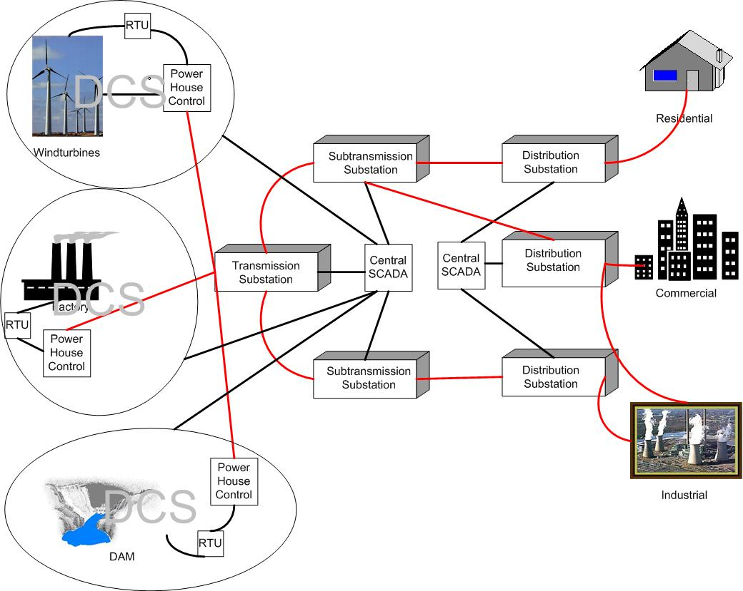
Power SCADA
NORWICH UNIVERISTY CENTER OF EXELLENCE IN DISTRIBUTED CONTROL SYSTEM SECURITY
power
control
SCADA SYSTEMS CLASSIFICATIONS (ILIA DORMISHEV, KRENAR KOMONI)

Slide 33
SCADA system types
NORWICH UNIVERISTY CENTER OF EXELLENCE IN DISTRIBUTED CONTROL SYSTEM SECURITY
Three types of basic SCADA systems:
  Basic SCADA
    One machine process
    One RTU and MTU
  Integrated SCADA
    Multiple RTUs
    DCS
  Networked SCADA
    Multiple SCADA
SCADA SYSTEMS CLASSIFICATIONS (ILIA DORMISHEV, KRENAR KOMONI)

Slide 34
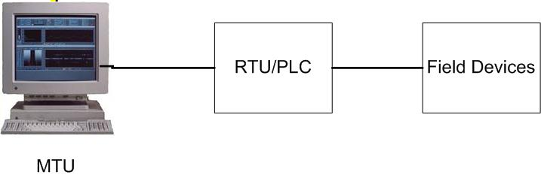
Basic SCADA
NORWICH UNIVERISTY CENTER OF EXELLENCE IN DISTRIBUTED CONTROL SYSTEM SECURITY
  Car manufacturing robot
  Room temperature control
SCADA SYSTEMS CLASSIFICATIONS (ILIA DORMISHEV, KRENAR KOMONI)

Slide 35
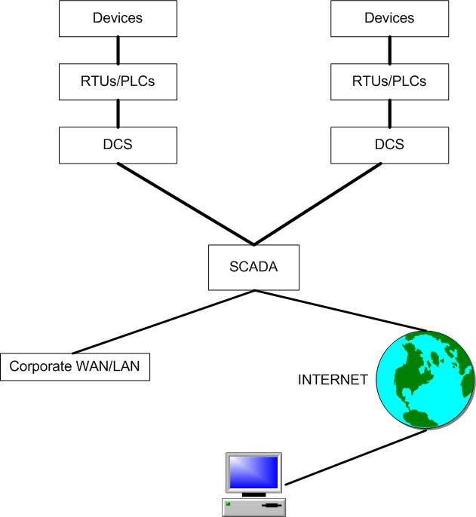
Integrated SCADA
NORWICH UNIVERISTY CENTER OF EXELLENCE IN DISTRIBUTED CONTROL SYSTEM SECURITY
Water systems
Subway systems
Security systems
SCADA SYSTEMS CLASSIFICATIONS (ILIA DORMISHEV, KRENAR KOMONI)

Slide 36
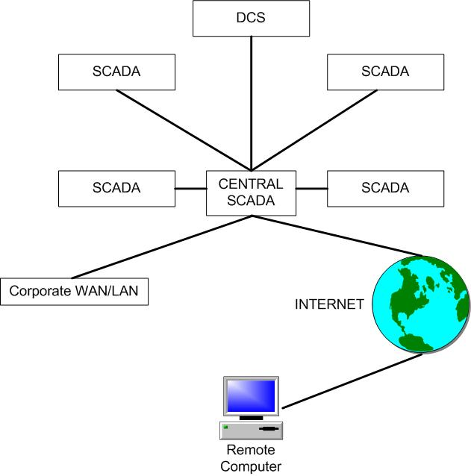
Networked SCADA
NORWICH UNIVERISTY CENTER OF EXELLENCE IN DISTRIBUTED CONTROL SYSTEM SECURITY
Power systems
Communication
systems
SCADA SYSTEMS CLASSIFICATIONS (ILIA DORMISHEV, KRENAR KOMONI)

Slide 37
Automation solutions
NORWICH UNIVERISTY CENTER OF EXELLENCE IN DISTRIBUTED CONTROL SYSTEM SECURITY
SCADA system manufacturers
  Modular SCADA, UK
  MOSCAD, Motorola
  Rockwell Automation
  ABCO
  ABB
  Lantronix
SCADA SYSTEMS CLASSIFICATIONS (ILIA DORMISHEV, KRENAR KOMONI)

Slide 38
SCADA Hardware
NORWICH UNIVERISTY CENTER OF EXELLENCE IN DISTRIBUTED CONTROL SYSTEM SECURITY
SCADA Hardware manufacturers
  Rockwell Allen Bradley
  General Electric (GE)
  Emerson
  Schneider Electric
SCADA SYSTEMS CLASSIFICATIONS (ILIA DORMISHEV, KRENAR KOMONI)

Slide 39
SCADA Software
NORWICH UNIVERISTY CENTER OF EXELLENCE IN DISTRIBUTED CONTROL SYSTEM SECURITY
SCADA Software manufacturers
  Intellution (Fix 32)
  Iconics (Genesis32 v7.0)
  Wonderware (InTouch)
  Citect (CitectSCADA 5.42)
  National Instruments (Lookout SCADA)
SCADA SYSTEMS CLASSIFICATIONS (ILIA DORMISHEV, KRENAR KOMONI)

Slide 40
Purpose of this research
NORWICH UNIVERISTY CENTER OF EXELLENCE IN DISTRIBUTED CONTROL SYSTEM SECURITY
Develop a teaching module for a general SCADA system
Develop a general model of a SCADA system
Use LabView and wireless communication computers
to illustrate an example of the SCADA system
Study the vulnerabilities of the SCADA system
Create a freshman introduction module
Create an upper level course for SCADA
SCADA SYSTEMS CLASSIFICATIONS (ILIA DORMISHEV, KRENAR KOMONI)

Slide 41
What is next?
NORWICH UNIVERISTY CENTER OF EXELLENCE IN DISTRIBUTED CONTROL SYSTEM SECURITY
Use the Laptop1 to generate the wells, tanks, servers, RTUs
PLCs and the front end processor through SubVIs
Use the Laptop2 to be the HMI Computer that connects to
Laptop1 and reads the data and also affect the devices
And Laptop3 to simulate an attack at the SCADA system
SCADA SYSTEMS CLASSIFICATIONS (ILIA DORMISHEV, KRENAR KOMONI)

Slide 42
Conclusion
NORWICH UNIVERISTY CENTER OF EXELLENCE IN DISTRIBUTED CONTROL SYSTEM SECURITY
There are thousands of SCADA systems installed and they
can be completely different from each other, in terms of
their structures but they all have common elements and
a common purpose – to supervise control and collect data.
There are three types of SCADA systems that describe
all of the SCADA systems.
Communication is the most significant part of SCADA
Power and communication systems are most likely to
get attacked by terrorists.
SCADA SYSTEMS CLASSIFICATIONS (ILIA DORMISHEV, KRENAR KOMONI)

Slide 43
Discussion
NORWICH UNIVERISTY CENTER OF EXELLENCE IN DISTRIBUTED CONTROL SYSTEM SECURITY
SCADA SYSTEMS CLASSIFICATIONS (ILIA DORMISHEV, KRENAR KOMONI)

